Slide 1

Domain: DL
Technology: Python
BRAIN DISEASE CLASSIFICATION ALONG WITH AGE ESTIMATION FROM MRI
<Name of the Students>

Slide 2
INDEX
Abstract
Introduction
Literature review
Existing Method
Drawbacks
Proposed method
Advantages
Implementation
Modules
Algorithms
Hardware and Software Requirements
Architecture
UML diagrams
Results
Conclusion
Future Scope
References

Slide 3
ABSTRACT
Chronological age of healthy people is able to be predicted accurately using deep neural networks from neuroimaging data, and the predicted brain age could serve as a biomarker for detecting aging-related diseases. Hence, in this proposed method we are using the cascade network of the deep learning which is a CNN,SVM and also the one of the machine learning algorithm named MobileNet. These algorithms are been used to train the brain MRI images which considered in the three classes as the Normal which is not effected with any disease and the other classes which were effected with Alzheimer’s disease (AD) and Mild Cognitive Impairment (MCI). From which we can also find out the ages from the classified images. SVM,CNN and MobileNet are mainly used for the training of the MRI image dataset, upon where the classification will be performed along with the age estimation.
Keywords: MRI, Age estimation, Alzheimer’s disease (AD) and Mild Cognitive Impairment, SVM,CNN deep learning, MobileNet, machine learning.

Slide 4
INTRODUCTION
Alzheimer's disease (AD) is a neurodegenerative disease that usually starts slowly and progressively worsens. It is the cause of 60–70% of cases of dementia. The most common early symptom is difficulty in remembering recent events. As the disease advances, symptoms can include problems with language, disorientation (including easily getting lost), mood swings, loss of motivation, self-neglect, and behavioral issues. As a person's condition declines, they often withdraw from family and society. Gradually, bodily functions are lost, ultimately leading to death. Although the speed of progression can vary, the typical life expectancy following diagnosis is three to nine years.
The cause of Alzheimer's disease is poorly understood. There are many environmental and genetic risk factors associated with its development. The strongest genetic risk factor is from an allele of APOE. Other risk factors include a history of head injury, clinical depression, and high blood pressure. The disease process is largely associated with amyloid plaques, neurofibrillary tangles, and loss of neuronal connections in the brain. A probable diagnosis is based on the history of the illness and cognitive testing with medical imaging and blood tests to rule out other possible causes. Initial symptoms are often mistaken for normal aging. Examination of brain tissue is needed for a definite diagnosis, but this can only take place after death.

Slide 5
INTRODUCTION
Good nutrition, physical activity, and engaging socially are known to be of benefit generally in aging, and these may help in reducing the risk of cognitive decline and Alzheimer's; in 2019 clinical trials were underway to look at these possibilities. There are no medications or supplements that have been shown to decrease risk.
No treatments stop or reverse its progression, though some may temporarily improve symptoms. Affected people increasingly rely on others for assistance, often placing a burden on the caregiver. The pressures can include social, psychological, physical, and economic elements. Exercise programs may be beneficial with respect to activities of daily living and can potentially improve outcomes. Behavioral problems or psychosis due to dementia are often treated with antipsychotics, but this is not usually recommended, as there is little benefit and an increased risk of early death.

Slide 6
LITERATURE REVIEW
S. No | Journal Type with year | Authors | Title | Outcomes
1 | The Lancet Neurology, vol. 9, no. 1, pp. 119–128, 2010 | C. R. Jack Jr | Hypothetical model of dynamic biomarkers of the Alzheimer’s pathological cascade | Alzheimer's pathological with cascading
2 | Neurology, vol. 72, no. 22, pp. 1906–1913, 2009 | I. Driscoll | Longitudinal pattern of regional brain volume change differentiates normal aging from MCI | Longitudinal pattern recognition of regional brain volume
3 | Neurobiology of aging, vol. 31, no. 9, pp. 1601–1605, 2010 | G. Spulber | Whole Brain Atrophy Rate Predicts Progression From MCI to Alzheimer’s Disease | Whole Brain Atrophy Rate Prediction
4 | PloS one, vol. 6, no. 7, 2011 | J. Dukart, M. L. Schroeter, K. Mueller | The Alzheimer’s Disease Neuroimaging Initiative, “Age correction in dementia–matching to a healthy brain | Age correction in dementia–matching to a healthy brain

Slide 7
EXISTING METHOD
This model emphasizes an existing method that which was designed using the some of the algorithms of machine learning. That which are used to classify the brain images which are effected with the some types of tumour or not. Here the process does not performed accurately with the algorithms that were used and classification is not up to the expected levels accuracy.

Slide 8
DISADVANTAGES
• Less feature compatibility
• Low accuracy
• Can consider only normal images

Slide 9
PROPOSED METHOD
In our proposed method we are using the cascade network of the deep learning which is a SVM,CNN and also the one of the machine learning algorithm named MobileNet. These algorithms are been used to train the brain MRI images which considered in the three classes as the Normal which is not effected with any disease and the other classes which were effected with Alzheimer’s disease (AD) and Mild Cognitive Impairment (MCI). From which we can also find out the ages from the classified images. SVM,CNN and MobileNet are mainly used for the training of the MRI image dataset, upon where the classification will be performed along with the age estimation.

Slide 10
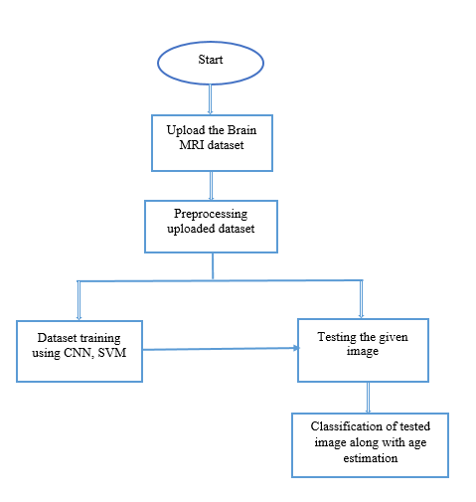
PROPOSED METHOD
Block diagram of proposed method

Slide 11
ADVANTAGES
• Accurate classification
• Less complexity
• High performance

Slide 12
IMPLEMENTATION
Firstly, we have collected the dataset of MRI images of brain, those which are divided into three classes.
Necessary pre-processing steps will be completed with the dataset before training with our algorithm.
Once after training the model will be saved for testing and classifying.
User can upload the images of which to be classified and by using the saved model the images will be classified and predicted.

Slide 13
MODULES
System
User
1. System:
1.1 Create Dataset:
The dataset containing images of the brain MRI images with the three different classes which are to be classified is split into training and testing dataset with the test size of 30-20%.
1.2 Pre-processing:
Resizing and reshaping the images into appropriate format to train our model.
1.3 Training:
Use the pre-processed training dataset is used to train our model using SVM,CNN and MobileNet algorithm.
1.4 Classification:
The results of our model is display of classified images with their species name as either it is as the MRI report is normal or effected with the disease.

Slide 14
MODULES
2. User:
2.1 View training accuracy
After training, user can view the training accuracy
2.2 Upload testing images
The images will be uploaded that are to be classified
2.3 View Results
The classified image results are viewed by user.

Slide 15
HARDWARE & SOFTWARE REQUIREMENTS
H/W Configuration:
• Processor - I3/Intel Processor
• Hard Disk -160GB
• RAM - 8Gb
S/W Configuration:
• Operating System : Windows 7/8/10 .
• IDE : Jupyter notebook.
• Libraries Used : Numpy, IO, OS, keras.
• Technology : Python 3.6+.

Slide 16
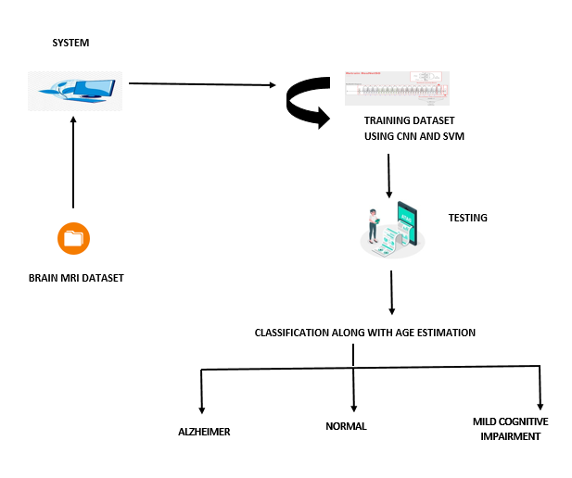
ARCHITECTURE

Slide 17
UML DIAGRAMS
A use case diagram in the Unified Modeling Language (UML) is a type of behavioral diagram defined by and created from a Use-case analysis. Its purpose is to present a graphical overview of the functionality provided by a system in terms of actors, their goals (represented as use cases), and any dependencies between those use cases. The main purpose of a use case diagram is to show what system functions are performed for which actor. Roles of the actors in the system can be depicted.

Slide 18
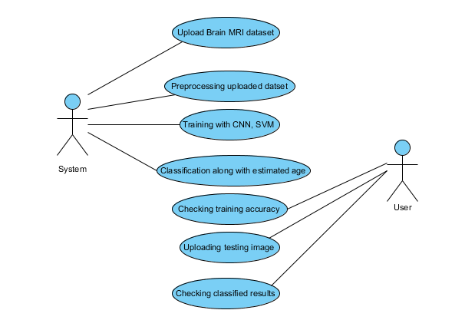

Slide 19
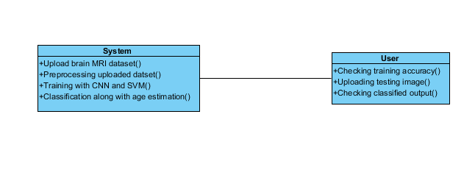
CLASS DIAGRAM
In software engineering, a class diagram in the Unified Modeling Language (UML) is a type of static structure diagram that describes the structure of a system by showing the system's classes, their attributes, operations (or methods), and the relationships among the classes. It explains which class contains information.

Slide 20
SEQUENCE DIAGRAM
A sequence diagram in Unified Modeling Language (UML) is a kind of interaction diagram that shows how processes operate with one another and in what order. It is a construct of a Message Sequence Chart. Sequence diagrams are sometimes called event diagrams, event scenarios, and timing diagrams.

Slide 21
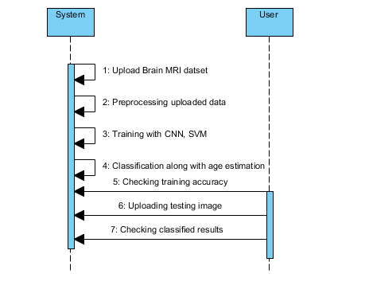

Slide 22
COLLABORATION DIAGRAM
In collaboration diagram the method call sequence is indicated by some numbering technique as shown below. The number indicates how the methods are called one after another. We have taken the same order management system to describe the collaboration diagram. The method calls are similar to that of a sequence diagram. But the difference is that the sequence diagram does not describe the object organization where as the collaboration diagram shows the object organization.

Slide 23
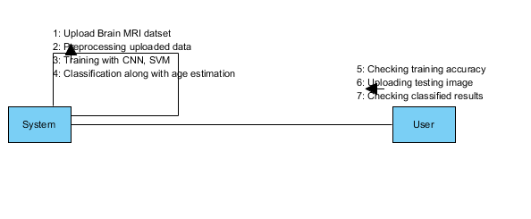

Slide 24
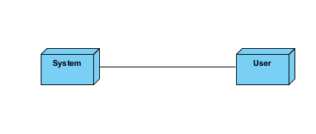
DEPLOYMENT DIAGRAM
Deployment diagram represents the deployment view of a system. It is related to the component diagram. Because the components are deployed using the deployment diagrams. A deployment diagram consists of nodes. Nodes are nothing but physical hardware used to deploy the application.

Slide 25
ACTIVITY DIAGRAM
Activity diagrams are graphical representations of workflows of stepwise activities and actions with support for choice, iteration and concurrency.
In the Unified Modeling Language, activity diagrams can be used to describe the business and operational step-by-step workflows of components in a system.
An activity diagram shows the overall flow of control.

Slide 26
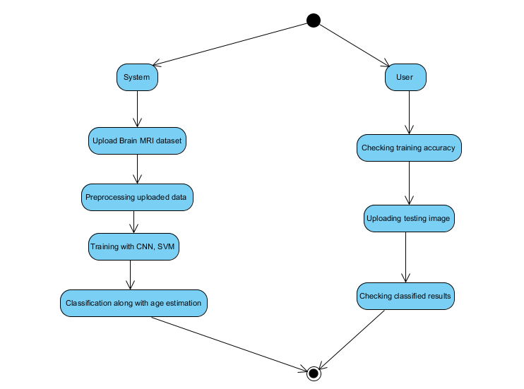

Slide 27
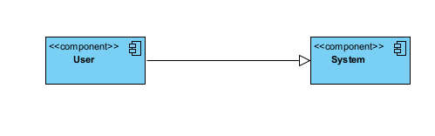
COMPONENT DIAGRAM
A component diagram, also known as a UML component diagram, describes the organization and wiring of the physical components in a system.
Component diagrams are often drawn to help model implementation details and double-check that every aspect of the system's required functions is covered by planned development.

Slide 28
ER DIAGRAM
An Entity–relationship model (ER model) describes the structure of a database with the help of a diagram, which is known as Entity Relationship Diagram (ER Diagram).
An ER diagram shows the relationship among entity sets. An entity set is a group of similar entities and these entities can have attributes.
In terms of DBMS, an entity is a table or attribute of a table in database, so by showing relationship among tables and their attributes, ER diagram shows the complete logical structure of a database.

Slide 29
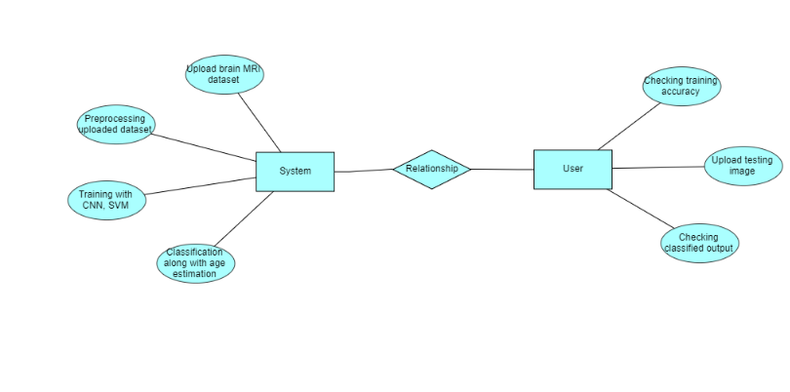

Slide 30
DF DIAGRAM
A Data Flow Diagram (DFD) is a traditional way to visualize the information flows within a system.
A neat and clear DFD can depict a good amount of the system requirements graphically. It can be manual, automated, or a combination of both.
It shows how information enters and leaves the system, what changes the information and where information is stored.
The purpose of a DFD is to show the scope and boundaries of a system as a whole.
It may be used as a communications tool between a systems analyst and any person who plays a part in the system that acts as the starting point for redesigning a system.

Slide 31
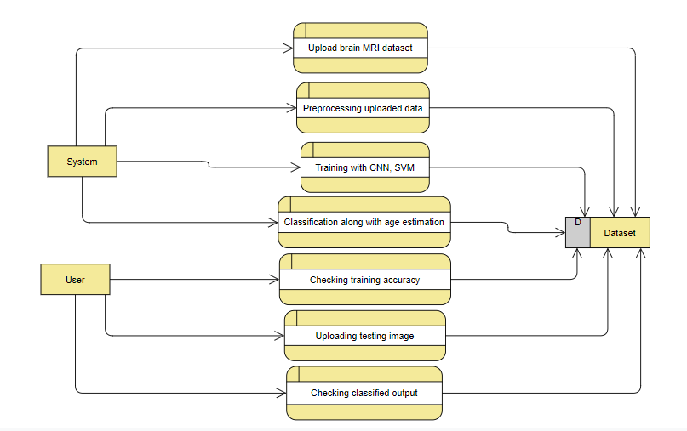

Slide 32
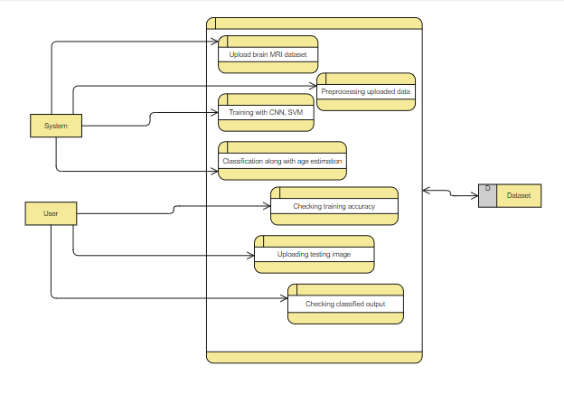

Slide 33
Results
In this application, we have considered the dataset of MRI brain images with three classes and trained using ResNet, MobileNet algorithms.
In the testing the image is uploaded and the image is classified.

Slide 34
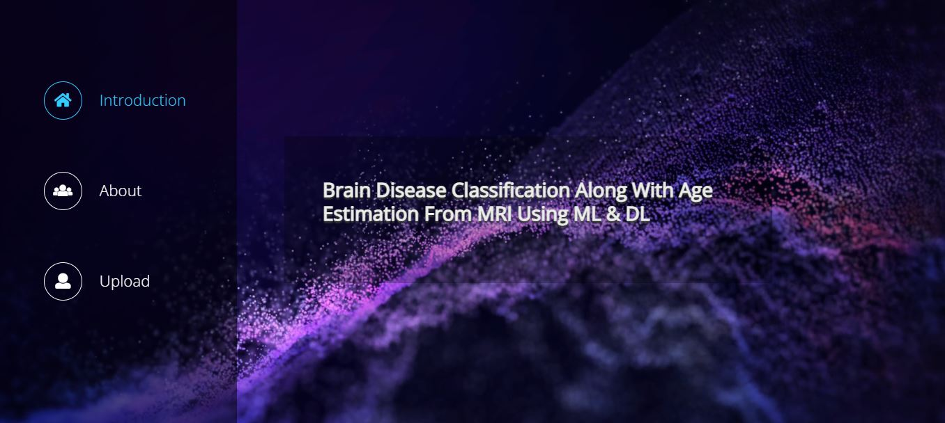
OUTPUT SCREEN SHOTS WITH DESCRIPTION
Home

Slide 35
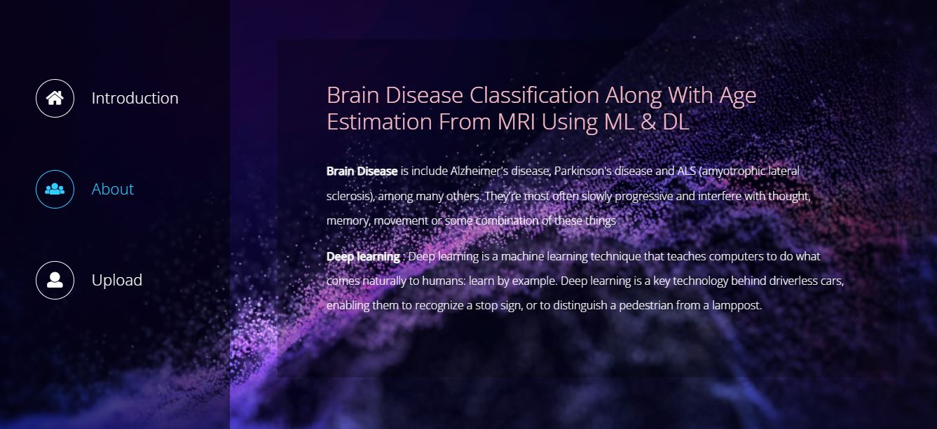
About

Slide 36

Upload

Slide 37
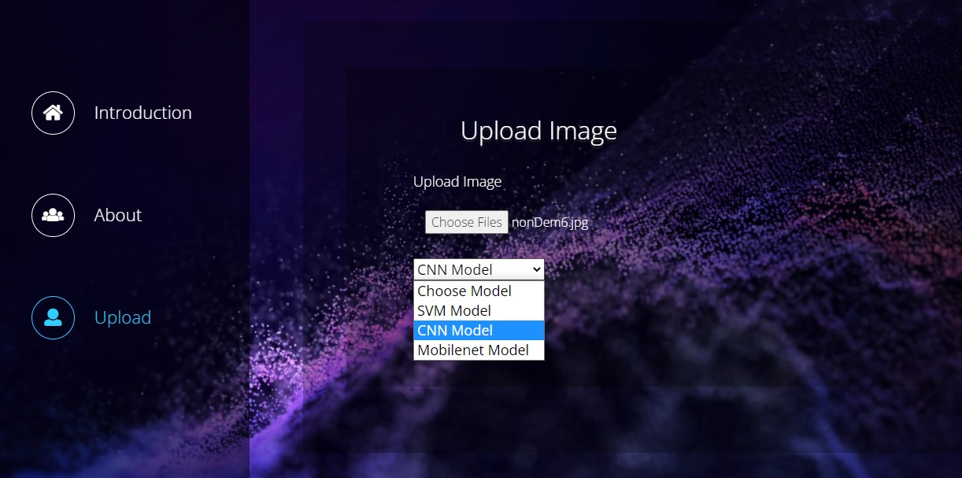
Model Selection

Slide 38

Result

Slide 39
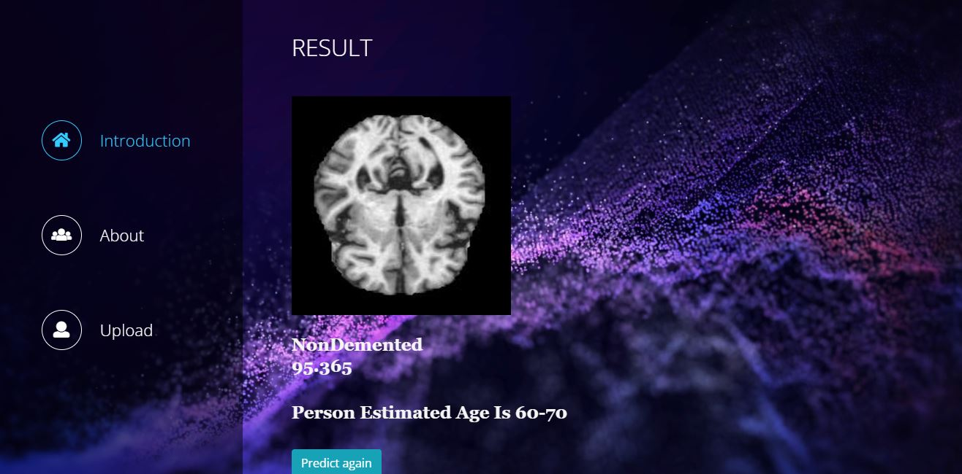

Slide 40
CONCLUSION
In this project we have successfully classified the brain MRI scanned images are normal or effected with the Alzheimer’s disease or Mild Cognitive Impairment. Along with the classification, the age is also estimated based on the classified output. This process is performed using the deep learning based ResNet and machine learning based MobileNet algorithms.

Slide 41
FUTURE SCOPE
In this project we have successfully classified the brain MRI scanned images are normal or effected with the Alzheimer’s disease or Mild Cognitive Impairment. Along with the classification, the age is also estimated based on the classified output. This process is performed using the deep learning based ResNet and machine learning based MobileNet algorithms.

Slide 42
REFERENCES
[1] C. Lopez-Ot ´ ´ın, M. A. Blasco, L. Partridge, M. Serrano, and G. Kroemer, “The hallmarks of aging,” Cell, vol. 153, no. 6, pp. 1194–1217, 2013.
[2] J. Bijsterbosch, “How old is your brain?” Nature neuroscience, vol. 22, no. 10, pp. 1611–1612, 2019.
[3] C. R. Jack Jr, et al., “Hypothetical model of dynamic biomarkers of the Alzheimer’s pathological cascade,” The Lancet Neurology, vol. 9, no. 1, pp. 119–128, 2010.
[4] I. Driscoll, et al., “Longitudinal pattern of regional brain volume change differentiates normal aging from MCI,” Neurology, vol. 72, no. 22, pp. 1906–1913, 2009.
[5] G. Spulber, et al., “Whole Brain Atrophy Rate Predicts Progression From MCI to Alzheimer’s Disease,” Neurobiology of aging, vol. 31, no. 9, pp. 1601–1605, 2010.
[6] J. Dukart, M. L. Schroeter, K. Mueller, The Alzheimer’s Disease Neuroimaging Initiative, “Age correction in dementia–matching to a healthy brain,” PloS one, vol. 6, no. 7, 2011.

